Slide 1
Array

Slide 2
Arrays
Motivation behind Array
You want to store 5 numbers in a computer
Define 5 variables, e.g. num1, num2, ..., num5
What, if you want to store 1000 numbers?
Defining 1000 variables is a good solution!
Requires much programming effort
Any better solution?
Yes, some structured data type
Array is one of the most common structured data types.
The idea of an array is to represent many instances in one variable.

Slide 3
Arrays
What is an Array?
An array in C++ is a collection of similar data items stored at contiguous memory locations and elements can be accessed randomly using indices of an array.
They can be used to store collection of primitive data types such as int, float, double, char.
Array is a static data structure which cannot grow or shrink during program execution – its size is fixed.

Slide 4
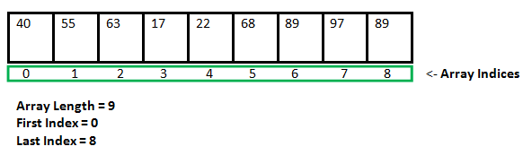
Arrays
Example
Given below is an example of an array.

Slide 5
Arrays
Array Declaration
There are various ways in which we can declare an array. It can be done by specifying its type and size, by initializing it or both.
Array declaration by specifying size
Array declaration by initializing elements
Array declaration by specifying size and initializing elements

Slide 6
Arrays
Array declaration by specifying size
// Array declaration by specifying size
int arr1[10];
// With recent C/C++ versions, we can also
// declare an array of user specified size
int n = 10; // n is a value from user
int arr2[n];

Slide 7
Arrays
Array declaration by initializing elements
// Array declaration by initializing elements
int arr[] = { 10, 20, 30, 40 }
// Compiler creates an array of size 4. The above
// is same as "int arr[4] = {10, 20, 30, 40}"

Slide 8
Arrays
Array declaration by specifying size and initializing elements
// Array declaration by specifying size and
// initializing elements
int arr[6] = { 10, 20, 30, 40 }
// Compiler creates an array of size 6,
// initializes first 4 elements as specified by // user and rest two elements as 0. above is
// same as "int arr[] = {10, 20, 30, 40, 0, 0}"

Slide 9
Arrays
Advantages of an Array in C/C++
Arrays represent multiple data items of the same type using a single name.
Elements can be accessed randomly by using the index number.
Easy access to all the elements.
Traversal through the array becomes easy using a single loop.
Sorting becomes easy as it can be accomplished by writing less line of code.

Slide 10
Arrays
Disadvantages of an Array in C/C++
An array is a static structure, which allows a fixed number of elements to be entered that is decided at the time of declaration.
Allocating more memory than the requirement leads to wastage of memory space and less allocation of memory also leads to a problem.

Slide 11
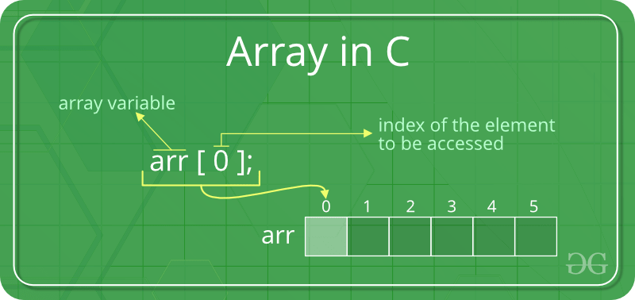
Arrays
Accessing Array Elements
Array elements are accessed by using an integer index. Array index starts with 0 and goes till size of array minus 1.

Slide 12
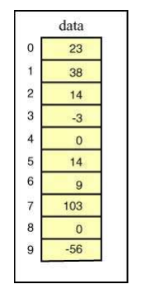
Arrays
Example
arr[-1] illegal
arr[6] illegal (6 > upper bound)
arr[1.5] illegal
arr[0] OK
arr[5] OK
What’s the difference between?
1. arr[2] + 10
2. arr[1] = arr[2] + 10

Slide 13
Arrays
Example
The elements are stored at contiguous memory locations
Size of integer in this compiler is 4
Address arr[0] is 0x7ffe75c32210
Address arr[1] is 0x7ffe75c32214
Address arr[2] is 0x7ffe75c32218
#include <iostream>
using namespace std;
int main() {
// an array of 10 integers. If arr[0] is stored at address x,
// then arr[1] is stored at x + sizeof(int) and arr[2] is stored at
// x + sizeof(int) + sizeof(int) and so on.
int arr[5], i;
cout << "Size of integer in this compiler is " << sizeof(int) << "\n";
for (i = 0; i < 5; i++)
// The use of '&' before a variable name, yields address of variable.
cout << "Address arr[" << i << "] is " << &arr[i] << "\n";
return 0;
}

Slide 14
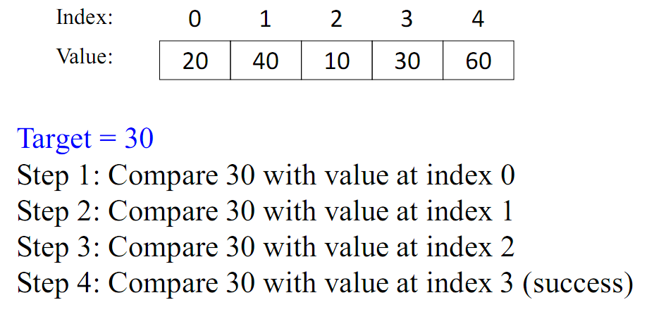
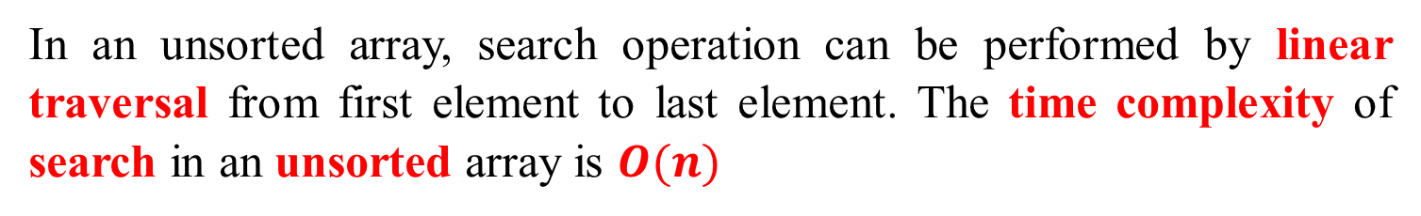
Arrays
Search in an unsorted array (Sequential Search)
In an unsorted array, search operation can be performed by linear traversal from first element to last element. The time complexity of search in an unsorted array is $O(n)$

Slide 15
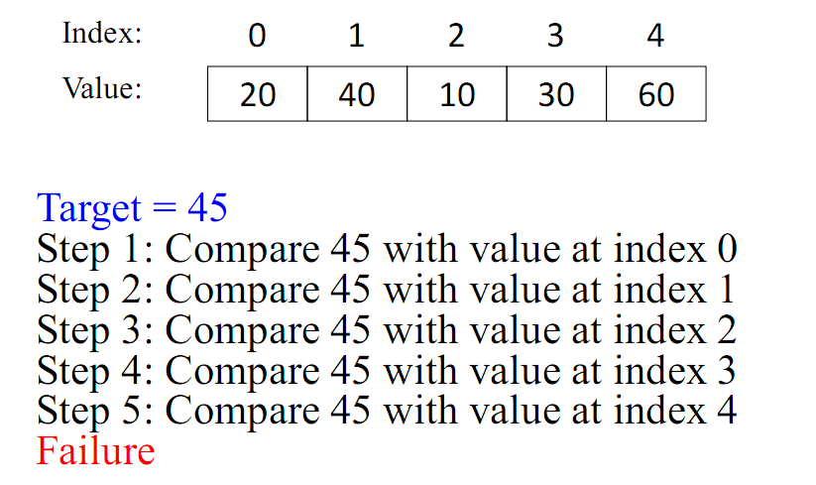
Arrays
Search in an unsorted array (Sequential Search)

Slide 16
Arrays
Search in an unsorted array (Sequential Search)
int main(){
int arr[] = {12, 34, 10, 6, 40};
int n = sizeof(arr) / sizeof(arr[0]);
// Using a last element as search element
int key = 40;
int index = findElement(arr, n, key);
if (index == - 1)
cout << "Element not found";
else
cout << "Element Found at index: " << index;
return 0;
}
12
34
10
6
40
n=5
key=40

Slide 17
Arrays
Search in an unsorted array (Sequential Search)
12
34
10
6
40
n=5
key=40
int findElement(int arr[], int n, int key){
int i;
for (i = 0; i < n; i++)
if (arr[i] == key)
return i;
return -1;
}
i=0
12
34
10
6
40
key=40

Slide 18
Arrays
Search in an unsorted array (Sequential Search)
12
34
10
6
40
n=5
key=40
int findElement(int arr[], int n, int key){
int i;
for (i = 0; i < n; i++)
if (arr[i] == key)
return i;
return -1;
}
i=1
12
34
10
6
40
key=40

Slide 19
Arrays
Search in an unsorted array (Sequential Search)
12
34
10
6
40
n=5
key=40
int findElement(int arr[], int n, int key){
int i;
for (i = 0; i < n; i++)
if (arr[i] == key)
return i;
return -1;
}
i=2
12
34
10
6
40
key=40

Slide 20
Arrays
Search in an unsorted array (Sequential Search)
12
34
10
6
40
n=5
key=40
int findElement(int arr[], int n, int key){
int i;
for (i = 0; i < n; i++)
if (arr[i] == key)
return i;
return -1;
}
i=3
12
34
10
6
40
key=40

Slide 21
Arrays
Search in an unsorted array (Sequential Search)
12
34
10
6
40
n=5
key=40
int findElement(int arr[], int n, int key){
int i;
for (i = 0; i < n; i++)
if (arr[i] == key)
return i;
return -1;
}
i=4
12
34
10
6
40
key=40

Slide 22
Arrays
Search in an unsorted array (Sequential Search)
12
34
10
6
40
n=5
key=40
int findElement(int arr[], int n, int key){
int i;
for (i = 0; i < n; i++)
if (arr[i] == key)
return i;
return -1;
}
i=4
12
34
10
6
40
key=40

Slide 23
Arrays
Search in an unsorted array (Sequential Search)
int main(){
int arr[] = {12, 34, 10, 6, 40};
int n = sizeof(arr) / sizeof(arr[0]);
// Using a last element as search element
int key = 40;
int index = findElement(arr, n, key);
if (index == - 1)
cout << "Element not found";
else
cout << "Element Found at index: " << index;
return 0;
}
12
34
10
6
40
index=4
Element Found at index: 4

Slide 24
Arrays
Search in an unsorted array (Sequential Search)
int main(){
int arr[] = {12, 34, 10, 6, 40};
int n = sizeof(arr) / sizeof(arr[0]);
// Using a last element as search element
int key = 50;
int index = findElement(arr, n, key);
if (index == - 1)
cout << "Element not found";
else
cout << "Element Found at index: " << index;
return 0;
}
12
34
10
6
40
n=5
key=50

Slide 25
Arrays
Search in an unsorted array (Sequential Search)
12
34
10
6
40
n=5
key=50
int findElement(int arr[], int n, int key){
int i;
for (i = 0; i < n; i++)
if (arr[i] == key)
return i;
return -1;
}
i=0
12
34
10
6
40
key=50

Slide 26
Arrays
Search in an unsorted array (Sequential Search)
12
34
10
6
40
n=5
key=50
int findElement(int arr[], int n, int key){
int i;
for (i = 0; i < n; i++)
if (arr[i] == key)
return i;
return -1;
}
i=1
12
34
10
6
40
key=50

Slide 27
Arrays
Search in an unsorted array (Sequential Search)
12
34
10
6
40
n=5
key=50
int findElement(int arr[], int n, int key){
int i;
for (i = 0; i < n; i++)
if (arr[i] == key)
return i;
return -1;
}
i=2
12
34
10
6
40
key=50

Slide 28
Arrays
Search in an unsorted array (Sequential Search)
12
34
10
6
40
n=5
key=50
int findElement(int arr[], int n, int key){
int i;
for (i = 0; i < n; i++)
if (arr[i] == key)
return i;
return -1;
}
i=3
12
34
10
6
40
key=50

Slide 29
Arrays
Search in an unsorted array (Sequential Search)
12
34
10
6
40
n=5
key=50
int findElement(int arr[], int n, int key){
int i;
for (i = 0; i < n; i++)
if (arr[i] == key)
return i;
return -1;
}
i=4
12
34
10
6
40
key=50

Slide 30
Arrays
Search in an unsorted array (Sequential Search)
12
34
10
6
40
n=5
key=40
int findElement(int arr[], int n, int key){
int i;
for (i = 0; i < n; i++)
if (arr[i] == key)
return i;
return -1;
}
i=4
12
34
10
6
40
key=40

Slide 31
Arrays
Search in an unsorted array (Sequential Search)
int main(){
int arr[] = {12, 34, 10, 6, 40};
int n = sizeof(arr) / sizeof(arr[0]);
// Using a last element as search element
int key = 40;
int index = findElement(arr, n, key);
if (index == - 1)
cout << "Element not found";
else
cout << "Element Found at index: " << index;
return 0;
}
12
34
10
6
40
index=-1
Element not found

Slide 32
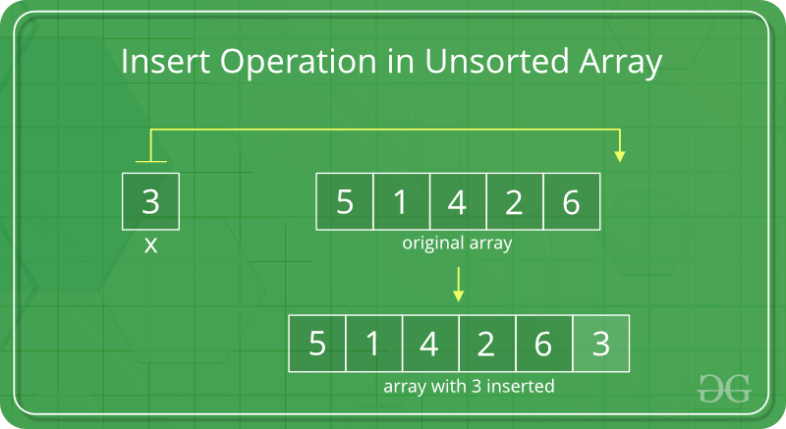
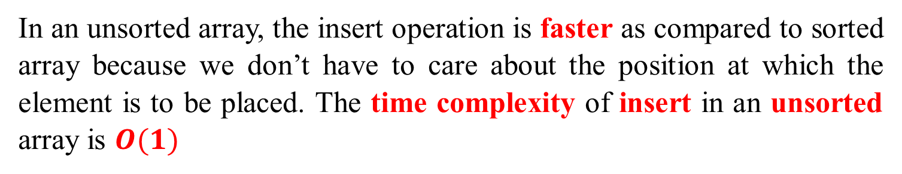
Arrays
Insert in an unsorted array
In an unsorted array, the insert operation is faster as compared to sorted array because we don’t have to care about the position at which the element is to be placed. The time complexity of insert in an unsorted array is $O(1)$

Slide 33
n=3
Insert in an unsorted array
int main(){
int arr[5] = {12, 16, 20};
int size = sizeof(arr) / sizeof(arr[0]);
int n = 3;
int key = 26;
cout << "\n Before Insertion: ";
for (int i = 0; i < n; i++)
cout << arr[i]<< " ";
if (n < size)
n = insertUnsorted(arr, n, key, capacity);
cout << "\n After Insertion: ";
for (int i = 0; i < n; i++)
cout << arr[i] << " ";
return 0;
}
12
16
20
0
0
size=5
n=3
key=26
12 16 20
√
Notes:
√

Slide 34
Insert in an unsorted array
12
16
20
0
0
n=3
key=26
size=5
int insertUnsorted(int arr[],int n,int key,int size){
arr[n] = key;
return (n + 1);
}
n=3
12
16
20
0
0
key=26

Slide 35
Insert in an unsorted array
12
16
20
0
0
n=3
key=26
size=5
int insertUnsorted(int arr[],int n,int key,int size){
arr[n] = key;
return (n + 1);
}
n=3
12
16
20
26
0
key=26

Slide 36
Insert in an unsorted array
12
16
20
0
0
n=3
key=26
size=5
int insertUnsorted(int arr[],int n,int key,int size){
arr[n] = key;
return (n + 1);
}
n=3
12
16
20
26
0
n=4
key=26

Slide 37
Insert in an unsorted array
int main(){
int arr[5] = {12, 16, 20};
int size = sizeof(arr) / sizeof(arr[0]);
int n = 3;
int key = 26;
cout << "\n Before Insertion: ";
for (int i = 0; i < n; i++)
cout << arr[i]<< " ";
if (n < size)
n = insertUnsorted(arr, n, key, capacity);
cout << "\n After Insertion: ";
for (int i = 0; i < n; i++)
cout << arr[i] << " ";
return 0;
}
12
16
20
26
0
size=5
n=3
key=26
12 16 20
n=4
12 16 20 26

Slide 38
Insert in an unsorted array
int main(){
int arr[5] = {12, 16, 20};
int size = sizeof(arr) / sizeof(arr[0]);
int n = 5;
int key = 30;
cout << "\n Before Insertion: ";
for (int i = 0; i < n; i++)
cout << arr[i]<< " ";
if (n < size)
n = insertUnsorted(arr, n, key, capacity);
cout << "\n After Insertion: ";
for (int i = 0; i < n; i++)
cout << arr[i] << " ";
return 0;
}
12
16
20
26
40
size=5
n=5
key=30
12 16 20 26 40
X
12 16 20 26 40

Slide 39
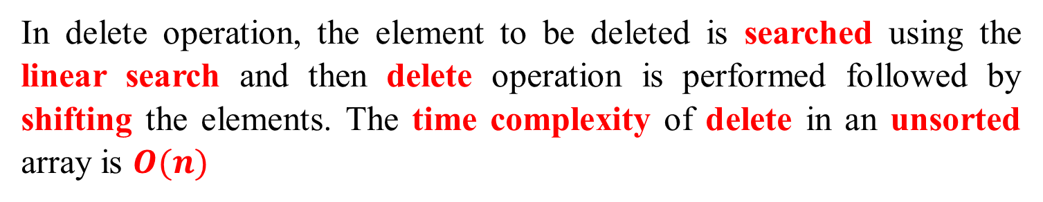
Delete in an unsorted array
Delete in an unsorted array
In delete operation, the element to be deleted is searched using the linear search and then delete operation is performed followed by shifting the elements. The time complexity of delete in an unsorted array is $O(n)$

Slide 40
Delete in an unsorted array
10
50
30
40
20
int main() {
int i;
int arr[] = {10, 50, 30, 40, 20};
int n = sizeof(arr) / sizeof(arr[0]);
int key = 30;
cout << "Array before deletion\n";
for (i = 0; i < n; i++)
cout << arr[i] <<" " ;
n = deleteElement(arr, n, key);
cout << "\n\nArray after deletion\n";
for (i = 0; i < n; i++)
cout << arr[i] << " ";
return 0;
}
size=5
key=30
10 50 30 40 20

Slide 41
Delete in an unsorted array
10
50
30
40
20
n=5
key=30
int deleteElement(int arr[], int n, int key) {
// Find position of element to be deleted
int pos = findElement(arr, n, key);
if (pos == - 1) {
cout << "Element not found";
return n;
}
// Deleting element
for (int i = pos; i < n - 1; i++)
arr[i] = arr[i + 1];
return n - 1;
}

Slide 42
Arrays
Search in an unsorted array (Sequential Search)
10
50
30
40
20
n=5
key=30
int findElement(int arr[], int n, int key){
int i;
for (i = 0; i < n; i++)
if (arr[i] == key)
return i;
return -1;
}
i=0
10
50
30
40
20
key=30

Slide 43
Arrays
Search in an unsorted array (Sequential Search)
10
50
30
40
20
n=5
key=50
int findElement(int arr[], int n, int key){
int i;
for (i = 0; i < n; i++)
if (arr[i] == key)
return i;
return -1;
}
i=1
10
50
30
40
20
key=30

Slide 44
Arrays
Search in an unsorted array (Sequential Search)
10
50
30
40
20
n=5
key=50
int findElement(int arr[], int n, int key){
int i;
for (i = 0; i < n; i++)
if (arr[i] == key)
return i;
return -1;
}
i=2
10
50
30
40
20
key=30

Slide 45
Delete in an unsorted array
10
50
30
40
20
n=5
key=30
int deleteElement(int arr[], int n, int key) {
// Find position of element to be deleted
int pos = findElement(arr, n, key);
if (pos == - 1) {
cout << "Element not found";
return n;
}
// Deleting element
for (int i = pos; i < n - 1; i++)
arr[i] = arr[i + 1];
return n - 1;
}
pos=2
i=2
10
50
30
40
20

Slide 46
Delete in an unsorted array
10
50
30
40
20
n=5
key=30
int deleteElement(int arr[], int n, int key) {
// Find position of element to be deleted
int pos = findElement(arr, n, key);
if (pos == - 1) {
cout << "Element not found";
return n;
}
// Deleting element
for (int i = pos; i < n - 1; i++)
arr[i] = arr[i + 1];
return n - 1;
}
pos=2
i=3
10
50
40
40
20

Slide 47
Delete in an unsorted array
10
50
30
40
20
n=5
key=30
int deleteElement(int arr[], int n, int key) {
// Find position of element to be deleted
int pos = findElement(arr, n, key);
if (pos == - 1) {
cout << "Element not found";
return n;
}
// Deleting element
for (int i = pos; i < n - 1; i++)
arr[i] = arr[i + 1];
return n - 1;
}
pos=2
i=4
10
50
40
20
20

Slide 48
Delete in an unsorted array
10
50
30
40
20
int main() {
int i;
int arr[] = {10, 50, 30, 40, 20};
int n = sizeof(arr) / sizeof(arr[0]);
int key = 30;
cout << "Array before deletion\n";
for (i = 0; i < n; i++)
cout << arr[i] <<" " ;
n = deleteElement(arr, n, key);
cout << "\n\nArray after deletion\n";
for (i = 0; i < n; i++)
cout << arr[i] << " ";
return 0;
}
size=5
key=30
10 50 30 40 20
n=4
10 50 40 20

Slide 49
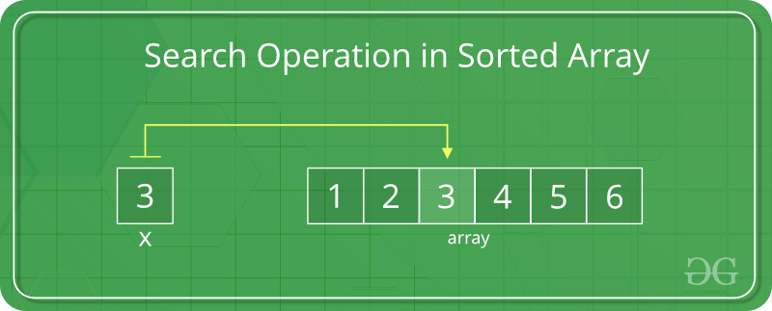
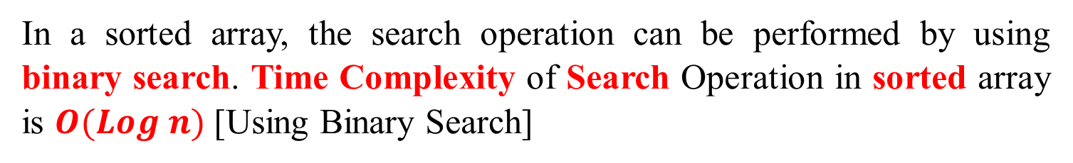
Arrays
Search in sorted array (Binary Search)
In a sorted array, the search operation can be performed by using binary search. Time Complexity of Search Operation in sorted array is $O(Log n)$[Using Binary Search]

Slide 50
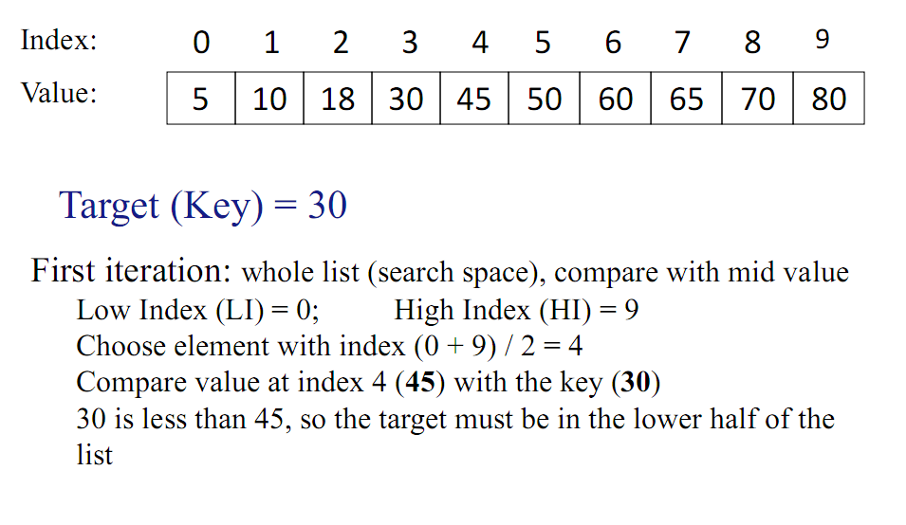
Arrays
Search in sorted array (Binary Search)

Slide 51
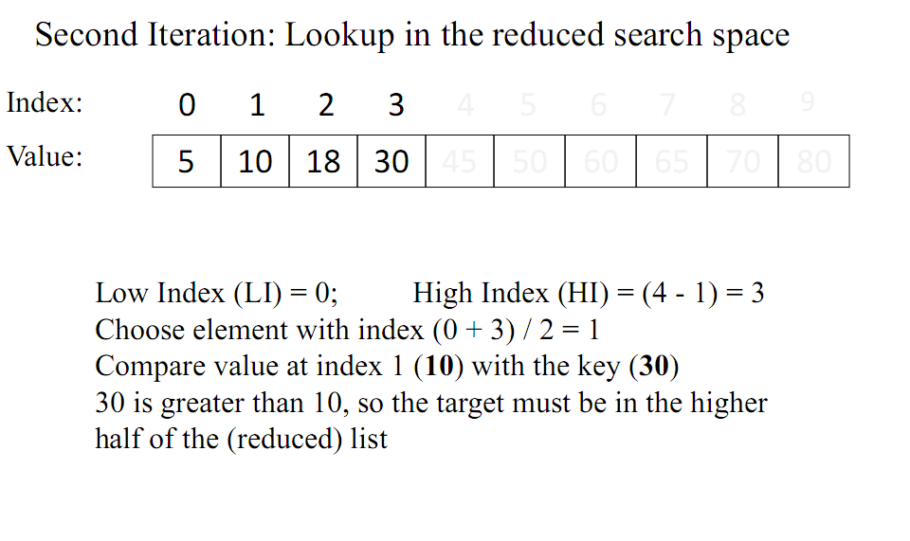
Arrays
Search in sorted array (Binary Search)

Slide 52
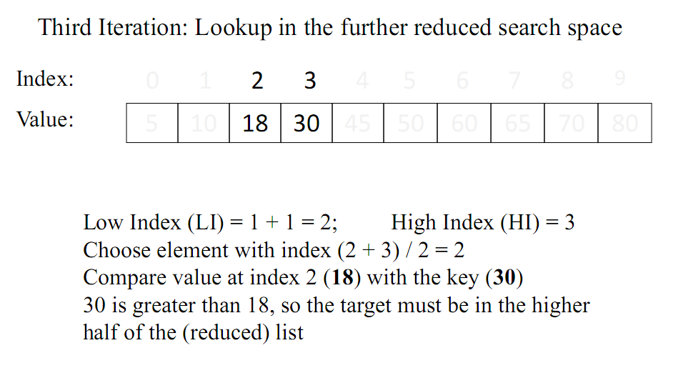
Arrays
Search in sorted array (Binary Search)

Slide 53
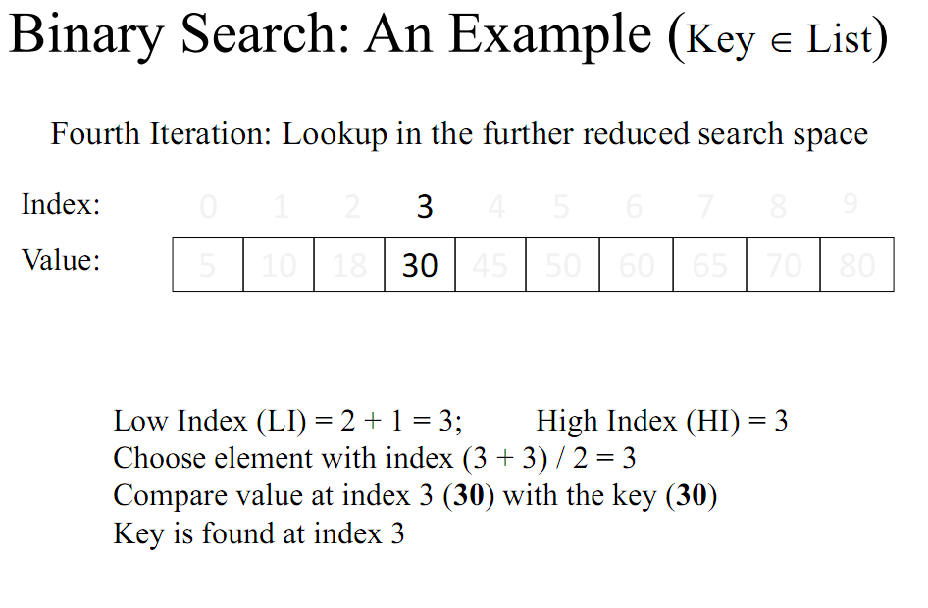
Arrays
Search in sorted array (Binary Search)

Slide 54
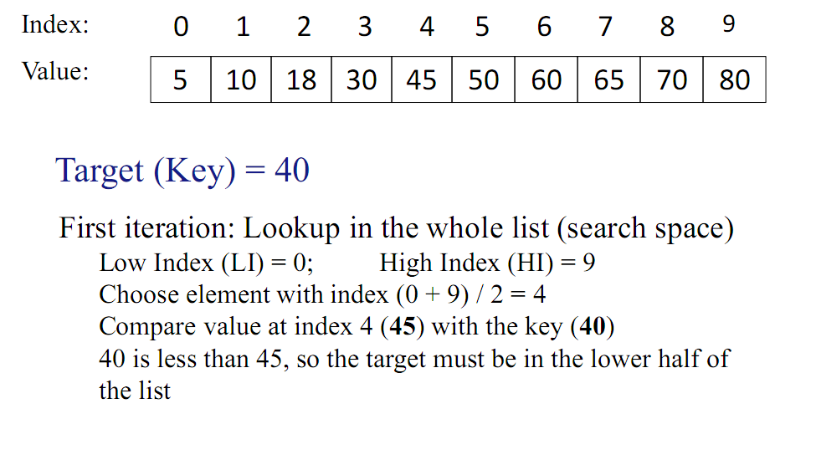
Arrays
Search in sorted array (Binary Search)

Slide 55
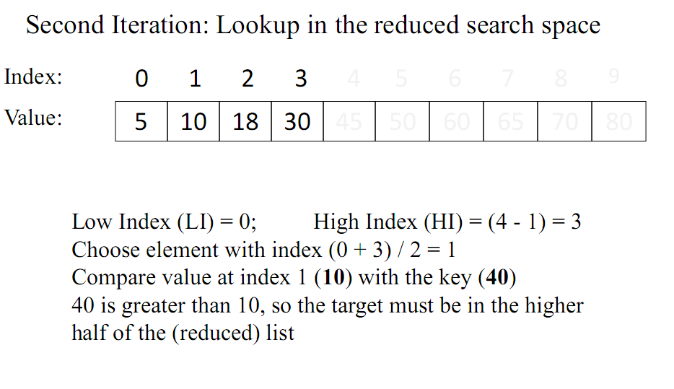
Arrays
Search in sorted array (Binary Search)

Slide 56
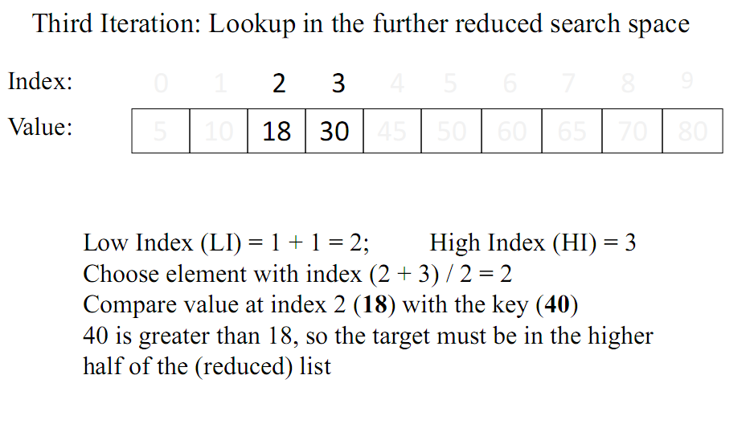
Arrays
Search in sorted array (Binary Search)

Slide 57
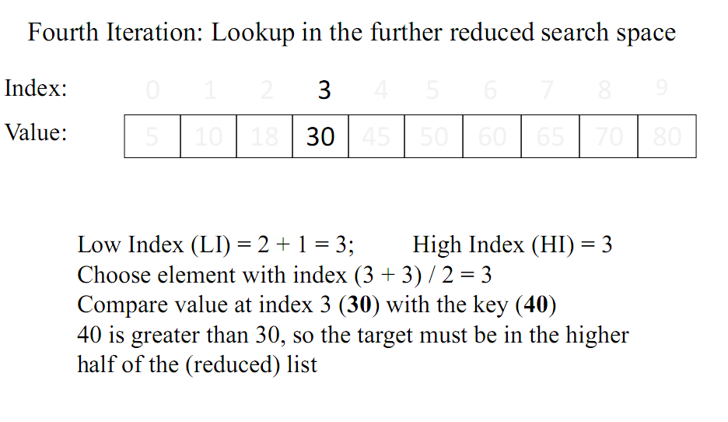
Arrays
Search in sorted array (Binary Search)

Slide 58
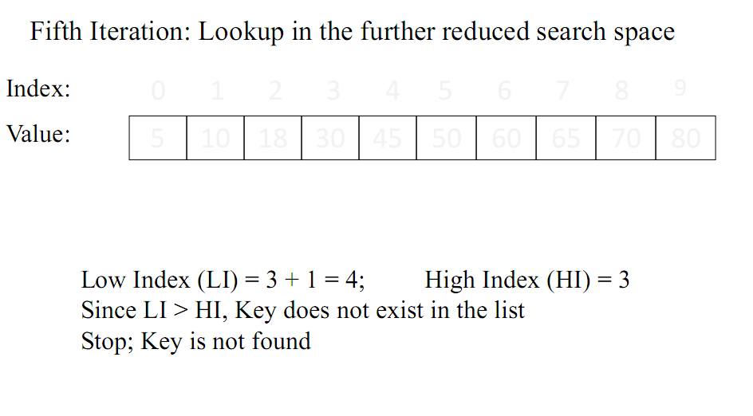
Arrays
Search in sorted array (Binary Search)

Slide 59
Search in sorted array (Binary Search)
int main() {
int arr[] = { 5, 6, 7, 8, 9, 10 };
int n, key;
n = sizeof(arr) / sizeof(arr[0]);
key = 10;
int index= binarySearch(arr, 0, n-1,key);
cout << "Index: " << index;
return 0;
}
5
6
7
8
9
10
n=6
key=10

Slide 60
Delete in an unsorted array
5
6
7
8
9
10
low=0
heigh=5
key=10
int binarySearch(int arr[], int low, int high, int key){
if (high < low)
return -1;
int mid = (low + high) / 2;
if (key == arr[mid])
return mid;
if (key > arr[mid])
return binarySearch(arr, (mid + 1), high, key);
return binarySearch(arr, low, (mid - 1), key);
}
mid=2
L=0
M=2
H=5
5
6
7
8
9
10

Slide 61
Delete in an unsorted array
5
6
7
8
9
10
low=3
heigh=5
key=10
int binarySearch(int arr[], int low, int high, int key){
if (high < low)
return -1;
int mid = (low + high) / 2;
if (key == arr[mid])
return mid;
if (key > arr[mid])
return binarySearch(arr, (mid + 1), high, key);
return binarySearch(arr, low, (mid - 1), key);
}
mid=4
L=3
M=4
H=5
5
6
7
8
9
10

Slide 62
Delete in an unsorted array
5
6
7
8
9
10
low=5
heigh=5
key=10
int binarySearch(int arr[], int low, int high, int key){
if (high < low)
return -1;
int mid = (low + high) / 2;
if (key == arr[mid])
return mid;
if (key > arr[mid])
return binarySearch(arr, (mid + 1), high, key);
return binarySearch(arr, low, (mid - 1), key);
}
mid=5
L,M,H=5
5
6
7
8
9
10

Slide 63
Search in sorted array (Binary Search)
int main() {
int arr[] = { 5, 6, 7, 8, 9, 10 };
int n, key;
n = sizeof(arr) / sizeof(arr[0]);
key = 10;
int index= binarySearch(arr, 0, n-1,key);
cout << "Index: " << index;
return 0;
}
5
6
7
8
9
10
n=6
key=10
index=5
Index: 5

Slide 64
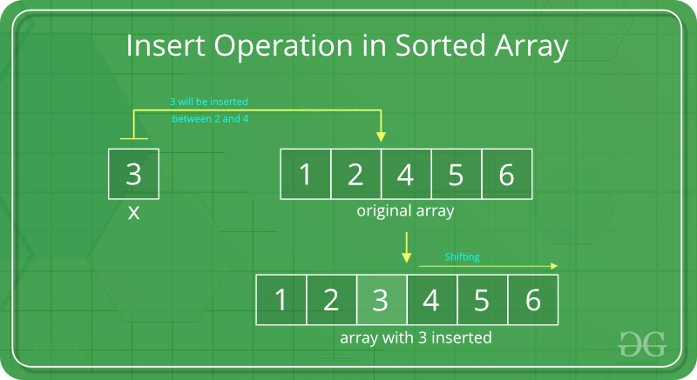
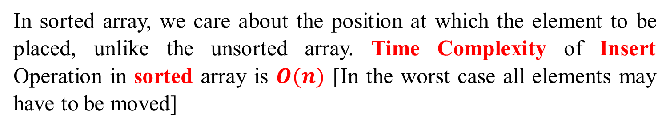
Arrays
Insert in sorted array
In sorted array, we care about the position at which the element to be placed, unlike the unsorted array. Time Complexity of Insert Operation in sorted array is $O(n)$ [In the worst case all elements may have to be moved]

Slide 65
Insert in sorted array
12
16
20
40
50
70
int main() {
int arr[20] = { 12, 16, 20, 40, 50, 70 };
int Size = sizeof(arr) / sizeof(arr[0]);
int n = 6;
int i, key = 26;
cout<< "\nBefore Insertion: ";
for (i = 0; i < n; i++)
cout << arr[i] << " ";
n = insertSorted(arr, n, key, Size);
cout << "\nAfter Insertion: ";
for (i = 0; i < n; i++)
cout << arr[i]<< " ";
return 0;
}
Size=20
n=6
key=26
12 16 20 40 50 70

Slide 66
Insert in sorted array
12
16
20
40
50
70
n=6
key=26
Size=20
int insertSorted(int arr[], int n, int key, int Size) {
if (n >= Size)
return n;
int i;
for (i = n - 1; (i >= 0 && arr[i] > key); i--)
arr[i + 1] = arr[i];
arr[i + 1] = key;
return (n + 1);
}
i=5
12
16
20
40
50
70
0

Slide 67
Insert in sorted array
12
16
20
40
50
70
n=6
key=26
Size=20
int insertSorted(int arr[], int n, int key, int Size) {
if (n >= Size)
return n;
int i;
for (i = n - 1; (i >= 0 && arr[i] > key); i--)
arr[i + 1] = arr[i];
arr[i + 1] = key;
return (n + 1);
}
i=4
12
16
20
40
50
70
70

Slide 68
Insert in sorted array
12
16
20
40
50
70
n=6
key=26
Size=20
int insertSorted(int arr[], int n, int key, int Size) {
if (n >= Size)
return n;
int i;
for (i = n - 1; (i >= 0 && arr[i] > key); i--)
arr[i + 1] = arr[i];
arr[i + 1] = key;
return (n + 1);
}
i=3
12
16
20
40
50
50
70

Slide 69
Insert in sorted array
12
16
20
40
50
70
n=6
key=26
Size=20
int insertSorted(int arr[], int n, int key, int Size) {
if (n >= Size)
return n;
int i;
for (i = n - 1; (i >= 0 && arr[i] > key); i--)
arr[i + 1] = arr[i];
arr[i + 1] = key;
return (n + 1);
}
i=2
12
16
20
26
40
50
70

Slide 70
Insert in sorted array
12
16
20
40
50
70
int main() {
int arr[20] = { 12, 16, 20, 40, 50, 70 };
int Size = sizeof(arr) / sizeof(arr[0]);
int n = 6;
int i, key = 26;
cout<< "\nBefore Insertion: ";
for (i = 0; i < n; i++)
cout << arr[i] << " ";
n = insertSorted(arr, n, key, Size);
cout << "\nAfter Insertion: ";
for (i = 0; i < n; i++)
cout << arr[i]<< " ";
return 0;
}
Size=20
n=6
key=26
12 16 20 40 50 70
n=7
12 16 20 26 40 50 70

Slide 71
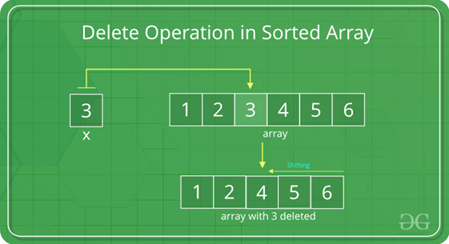
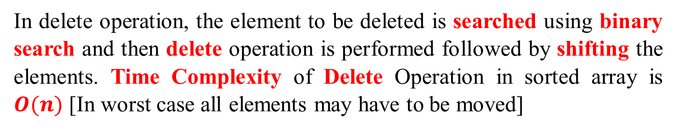
Arrays
Delete in sorted array
In delete operation, the element to be deleted is searched using binary search and then delete operation is performed followed by shifting the elements. Time Complexity of Delete Operation in sorted array is $O(n)$ [In worst case all elements may have to be moved]

Slide 72
Delete in sorted array
int main(){
int i;
int arr[] = { 10, 20, 30, 40, 50 };
int n = sizeof(arr) / sizeof(arr[0]);
int key = 30;
cout << "Array before deletion\n";
for (i = 0; i < n; i++)
cout << arr[i] << " ";
n = deleteElement(arr, n, key);
cout << "\n\nArray after deletion\n";
for (i = 0; i < n; i++)
cout << arr[i] << " ";
}
Array before deletion
10, 20, 30, 40, 50

Slide 73
Delete in sorted array
int deleteElement(int arr[], int n, int key) {
int pos = binarySearch(arr, 0, n - 1, key);
if (pos == -1) {
cout << "Element not found";
return n;
}
int i;
for (i = pos; i < n - 1; i++)
arr[i] = arr[i + 1];
return n - 1;
}

Slide 74
Delete in sorted array
int binarySearch(int arr[], int low, int high, int key) {
if (high < low)
return -1;
int mid = (low + high) / 2;
if (key == arr[mid])
return mid;
if (key > arr[mid])
return binarySearch(arr, (mid + 1), high, key);
return binarySearch(arr, low, (mid - 1), key);
}

Slide 75
Delete in sorted array
int main(){
int i;
int arr[] = { 10, 20, 30, 40, 50 };
int n = sizeof(arr) / sizeof(arr[0]);
int key = 30;
cout << "Array before deletion\n";
for (i = 0; i < n; i++)
cout << arr[i] << " ";
n = deleteElement(arr, n, key);
cout << "\n\nArray after deletion\n";
for (i = 0; i < n; i++)
cout << arr[i] << " ";
}
Array after deletion
10, 20, 40, 50

Slide 76
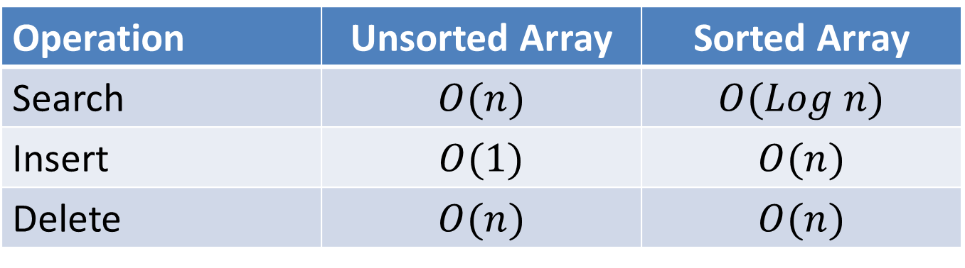
Arrays
Time Complexity
Operation | Unsorted Array | Sorted Array
Search | $$O(n)$$ | $$O(Log n)$$
Insert | $$O(1)$$ | $$O(n)$$
Delete | $$O(n)$$ | $$O(n)$$

Slide 77
THANKS for your attention

Slide 78
https://teams.microsoft.com/l/team/19%3A-uly1h8OBtImWtcNKoTDHyYNWPXtx3enFOgY27T4kNY1%40thread.tacv2/conversations?groupId=9990e5b6-4fee-43ae-85dd-784aafa98e7a&tenantId=29d02b7a-fa50-40cc-8d1c-a452a519c6a5

